Slide 1
Miners and Ranchers
Chapter 12 Section 4
Mr. McClintock

Slide 2
Learning Objectives
Students will be able to understand the importance of the rise in mining and ranching operations
Students will be able to identify the difference between placer and quartz mining
Students will be able to describe the two major factors that led to the decline of the cattle business

Slide 3
Importance of the subject
United States Pre-War
United States in 1880’s
Western Pacific
Great Plains
What do you think contributed to the expansion into the west?

Slide 4
Mining techniques
Placer Mining
Quartz Mining
Surface mining
Pick Axes, Shovels, Pans
Quick and easy
Digging deep underneath the surface
More expensive
Remember these are poor people travelling into the west with hopes of “striking gold”

Slide 5
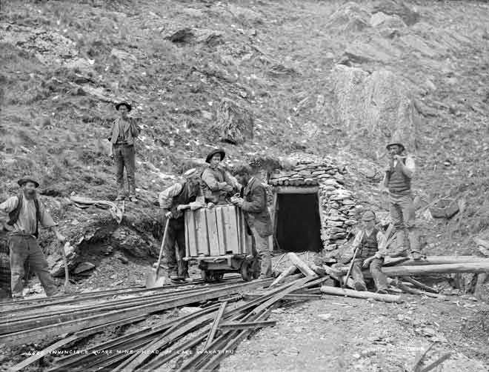
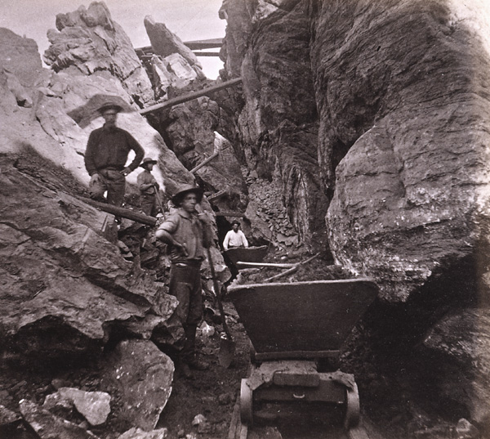
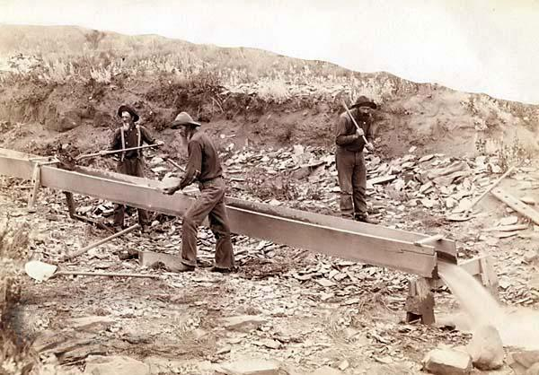
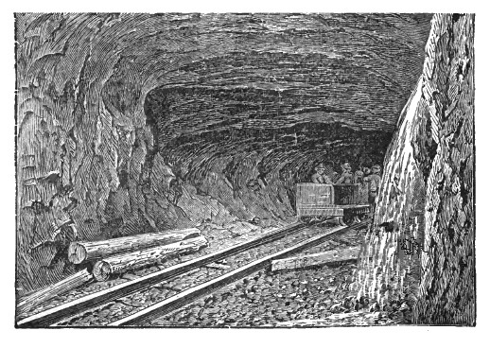
Placer or quartz?

Slide 6
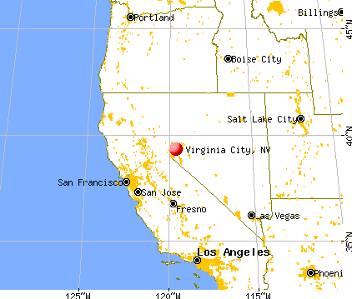
The big strike in Nevada
1859, Henry Comstick claimed land in Six-Mile Canyon, NV
Found the sticky blue-gray mud to be pure silver ore
Virginia City, NV went from boomtown to 30,000 population
New Opera House
New shops
Creation of more newspapers
First elevator called the “rising room”
Name another famous city that went from rags to riches?
Findlay, Ohio – Natural Gas
What famous city did Virginia City, NV become in the years following?

Slide 7
Several Years later…
Silver veins were exhausted
Mines closed
City economy collapsed
Growing trend throughout mining cities
Ultimately, Virginia City Nevada failed..

Slide 8
Silver Vein

Slide 9
During the Booms
People flocked to the boom cities
What rises when mass amounts of people come to small cities?
Crime
Vigilance Committees- formed to track down criminals and punish wrong doers

Slide 10
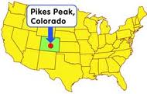
Other bonanzas
Spurred the development of Colorado, the Dakota Territory, and Montana
Pikes Peak
Thousands of people flocked to pan for gold
BUT!!!! The gold and silver were too deep into the Colorado Mountains
What kind of mining should they have conducted?

Slide 11
Effects of the Bonanzas
Mass population movement
Leadville, Colorado 1879
Thousand newcomers per week
Creation of Railroads through the Rocky Mountains
Discovery of Gold in the Black Hills
Mount Rushmore
Conquest against Native Americans
1889, Congress admits North and South Dakota, and Montana

Slide 12
Take 2-3 minutes to write down the main points of the new mining operations in sentence form

Slide 13
Sports Teams related to Mining
San Francisco
49ers
Denver
Nuggets
University of Texas at El Paso (UTEP)
Miners

